Slide 1
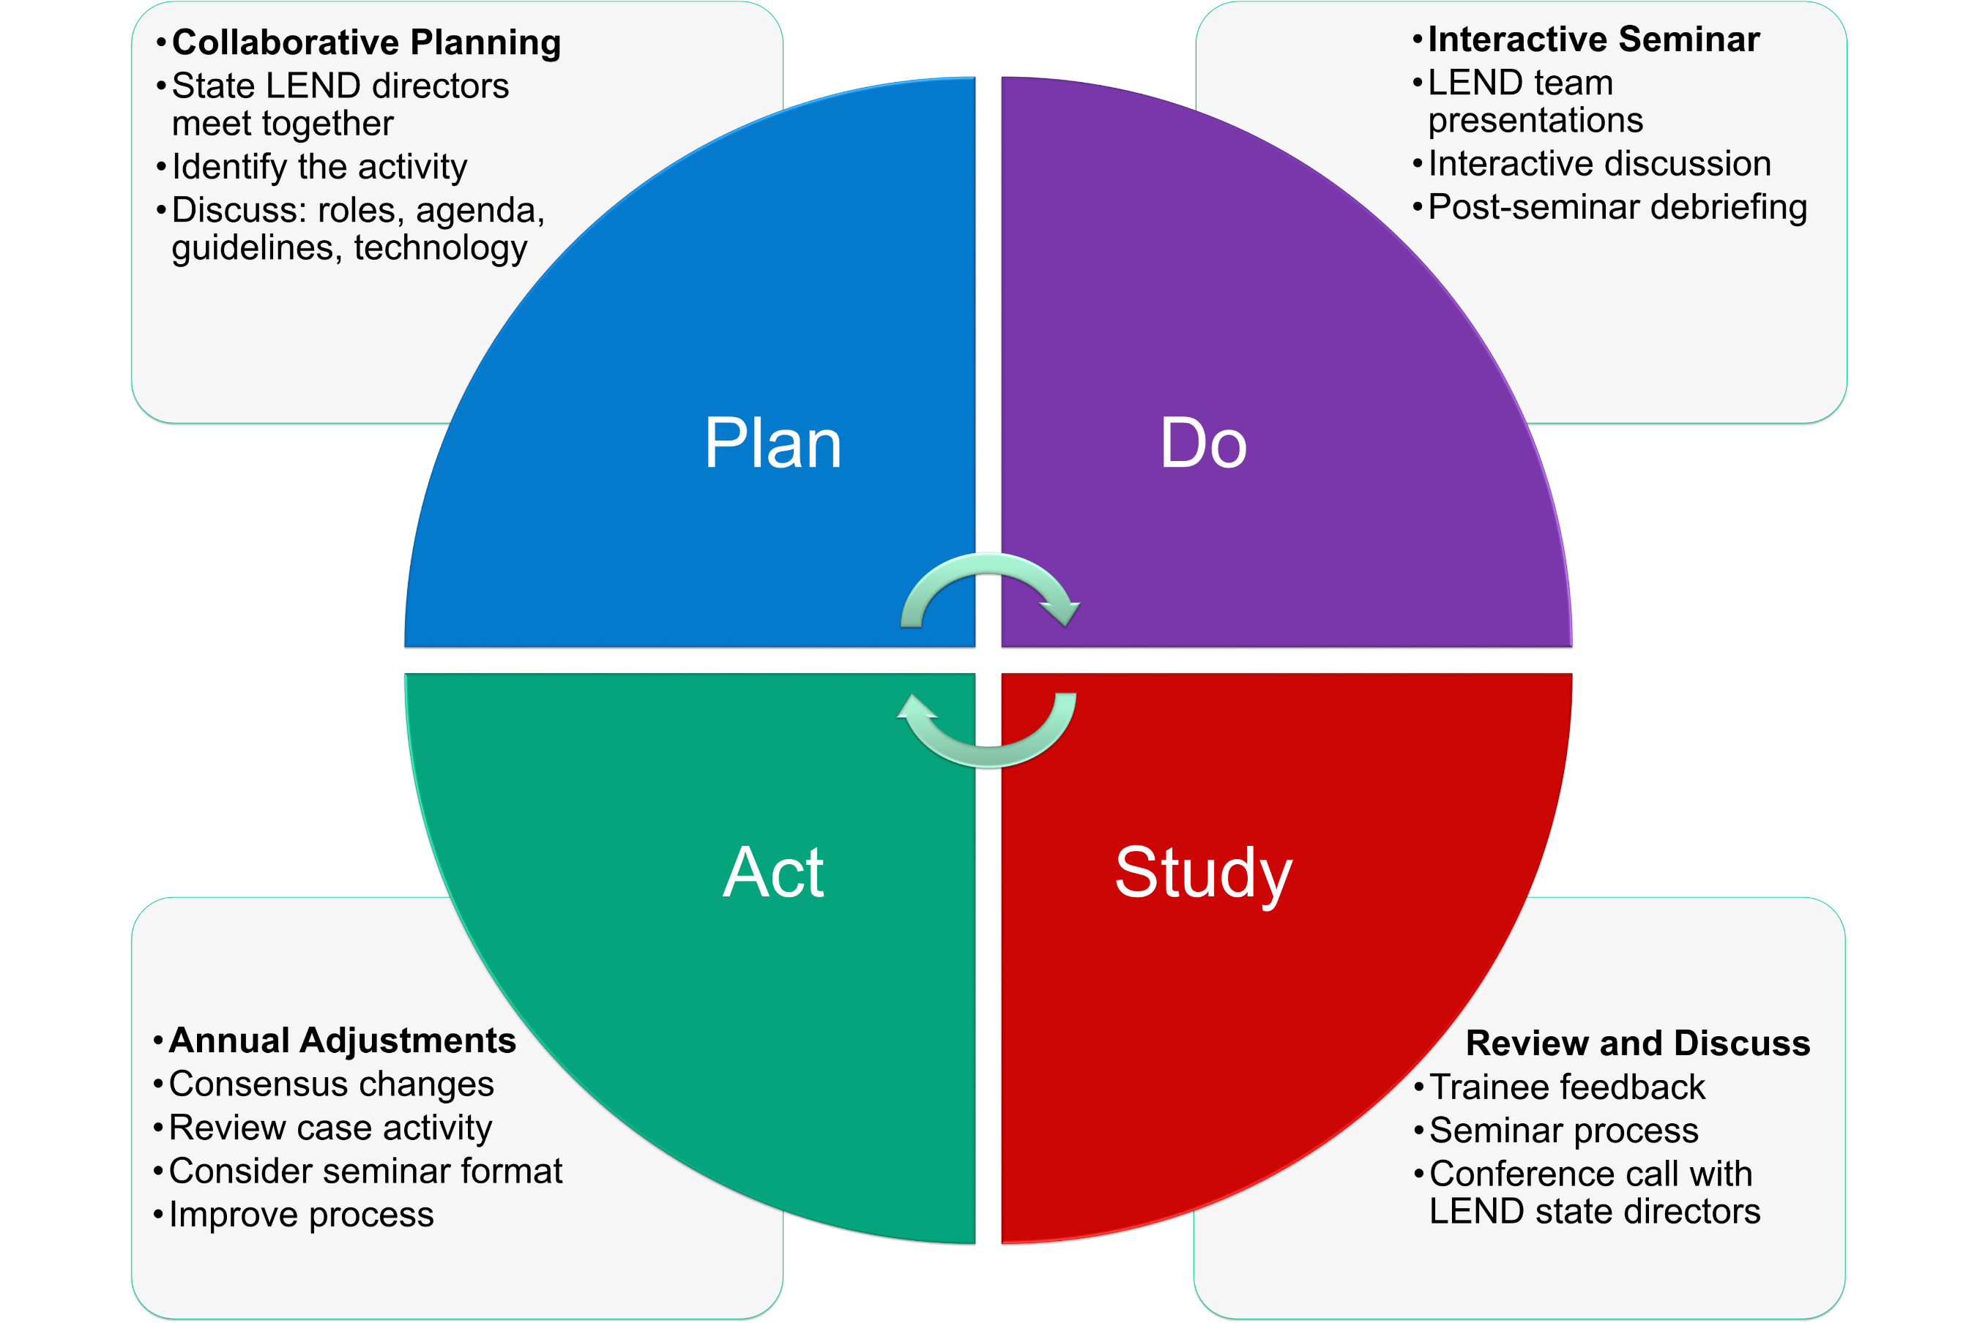
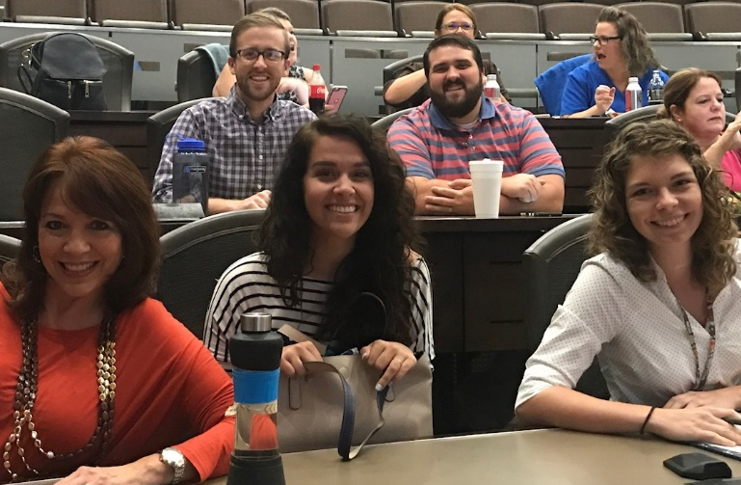
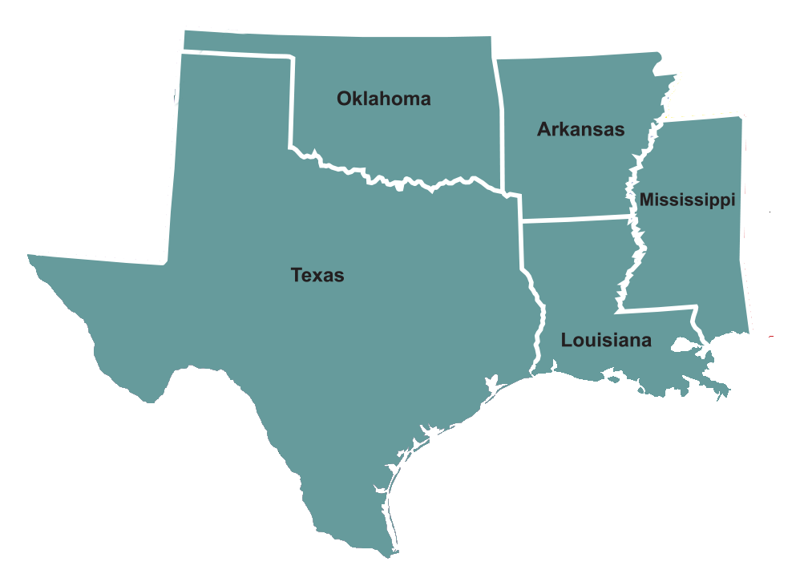
Collaborative Seminars Connect and Inspire LEND Trainees Across the Southern Region
Leadership Education in Neurodevelopmental and related Disabilities (LEND)
Arkansas, Louisiana, Southern Mississippi, Oklahoma, and Texas
Megan Peters, DSc; Linda Wilson, PhD; Mark Wolraich, MD; Jerry Alliston, PhD; Beth Bryant, PhD;
David Deere, MSW; Pauline A. Filipek, MD; Deborah Pearson, PhD; Eldon Schultz, MD; Phil Wilson, PhD
Purpose
This presentation describes the collaborative, interactive learning process used by the Southern Region LEND Programs, including information about the lessons learned and how the activity has evolved over several years, and how Trainees have responded to the experience.
Background
Southern Region LEND programs developed a collaborative, interactive seminar to engage LEND Trainees and Faculty across five states. Trainees connect using video technology in a shared case-based learning experience. Teams of Trainees from each state discuss their approach to the case centered on the core values of interdisciplinary, family-centered, culturally competent and inclusive community based services, and share ideas for enhancing leadership and advocacy around these core values as they relate to the case. Trainees share information about available services and programs in their states.
Reflections from Southern Region LEND Trainees on the Collaborative Seminar
The seminar helped to increase insight into some programs or activities that would be helpful to implement in [our state]. The seminar helped me to challenge myself and seek more information about the case, our competency, and appropriate solutions.
I was happy to just be part of the Southern LEND Regional Collaborative Seminar as a self-advocate. It allowed us to work together as a team and I got to do the introduction. It was good being part of the team and the seminar.
The Southern LEND Regional Collaborative Seminar was one of my favorite parts of LEND last year. This presentation project allowed us to look at a case closely and look into a certain LEND Core Principles more. I liked that each state got to share what their state was doing actively that was related to each principle. It honestly felt like we were an actual professional interdisciplinary team. It allowed us to gain different perspectives from each state and to help each other grow professionally.
Our time during the collaborative allowed us to experience other teams, as well as improve our methods of teaming. Something I am taking away from this experience is a better understanding of how an effective team works.
I found it very interesting to hear the other programs’ takes on helping children with disabilities, as well as their families. I appreciate that each multidisciplinary team is different and they will each have a different takes on the same situation. Something important I learned about our own program is that our team has great communication between its members.
I wasn’t alone in front of that microphone. I didn’t have to do it alone.
I was with my team.
Next Steps
Create additional activities to increase interaction among LEND Trainees across the region
Consider identifying Trainee Liaisons to communicate across programs
Develop strategies to maintain connections among Graduated Trainees from LEND programs across the region
Examine the impact of collaborative inter-state activities on LEND Trainees
Significance of the Collaborative Seminar
The collaborative interactive learning experience helps LEND Trainees feel connected across a larger network and provides a forum for sharing ideas that inspire leadership and advocacy.
LEND Trainees hear new perspectives and also discover their similarities related to the core principles of interdisciplinary, family-centered, culturally competent, and inclusive community services.
Building connections across programs in the AUCD network is essential to forming a strong voice in the nation to improve services for individuals with disabilities and their families
References
MCH Leadership Competencies at https://www.mchnavigator.org/trainings/competencies.php
Association of University Centers on Disabilities (AUCD) at http://www.aucd.org/template/index.cfm
Student-Directed Teaching at http://www.aucd.org/itac/template/strategy.cfm?id=39
Oklahoma LEND
Maternal and Child Health Bureau Grant T73MC00033
Health Resources and Services Administration
U.S. Department of Health and Human Services

Slide 2
Plan
Collaborative Planning
Do
Interactive Seminar
Study
Trainee feedback
Act
State LEND directors meet together
Discuss: roles, agenda, guidelines, technology
Identify the activity
LEND team presentations
Interactive discussion
Post-seminar debriefing
Review and Discuss
Conference call with LEND state directors
Seminar process
Annual Adjustments
Consensus changes
Review case activity
Consider seminar format
Improve process

